Slide 1
Simulation of SI and SIR Models
By: Shubhrose Singh

Slide 2
SI Epidemiological Model
b = likelihood that an infectious node will infect a susceptible node
n = number of nodes
Time for |S| = 0 | b= 0.01 | b= 0.005 | b= 0.001
n= 100 | 14 | 23 | 85
n= 250 | 7 | 12 | 56
n= 500 | 6 | 7 | 32
n= 750 | 4 | 6 | 20
Insights
As the number of nodes increases the time to infect everyone decreases
As the beta value decreases the time to infect everyone increases

Slide 3
SIR Epidemiological Model
g = likelihood that an infectious node will recover
All recovered | g = 0.01 | g = 0.05 | g = 0.1
n= 100, b=0.01 | 460 | 109 | 45
No susceptible left | g = 0.1
n= 100, b=0.01 | 13
n= 250, b=0.01 | 6
n= 500, b=0.01 | 6
n= 750, b=0.01 | 5
All recovered | g = 0.1
n= 100, b=0.01 | 51
n= 250, b=0.01 | 50
n= 500, b=0.01 | 59
n= 750, b=0.01 | 48
Insights
As gamma increases, time for everyone to recover decreases
As n increases time until everyone recovers not greatly affected

Slide 4
SI Epidemiological Model using Barabasi Albert Graph
d = degree of each new node added for Barabasi Albert Graph
No Susceptible Left | d= 8 | d= 16 | d= 32
n= 100, b = 0.01 | 84 | 58 | 26
No Susceptible Left | d= 8
n= 100, b = 0.01 | 84
n= 250, b = 0.01 | 109
n= 500, b = 0.01 | 129
n= 750, b = 0.01 | 107
Insights
As d increases, time to infect all susceptible decreases
As n increases, time to infect all susceptible increases slightly

Slide 5
SIR Epidemiological Model using Watts Strogatz Graph
b_watts = probability of replacing edge in ring lattice with new edge for Watts Strogatz Graph
d = degree of node in ring lattice for Watts Strogatz Graph
No Susceptible Left | d = 8 | d = 16 | d = 32
n= 100, b_watt = 0.5, b = 0.01 | 84 | 58 | 26
No Susceptible Left | d= 8
n= 100, b = 0.01 | 84
n= 250, b = 0.01 | 109
n= 500, b = 0.01 | 129
n= 750, b = 0.01 | 107
No Susceptible Left | b_watt = 8 | b_watt = 16 | b_watt = 32
n= 100, d = 8, b = 0.01 | 84 | 58 | 26
Insights
As d increases, time to infect all susceptible decreases
As b_watt value increases, time to infect all susceptible decreases
As n increases, time to infect all susceptible increases slightly

Slide 6
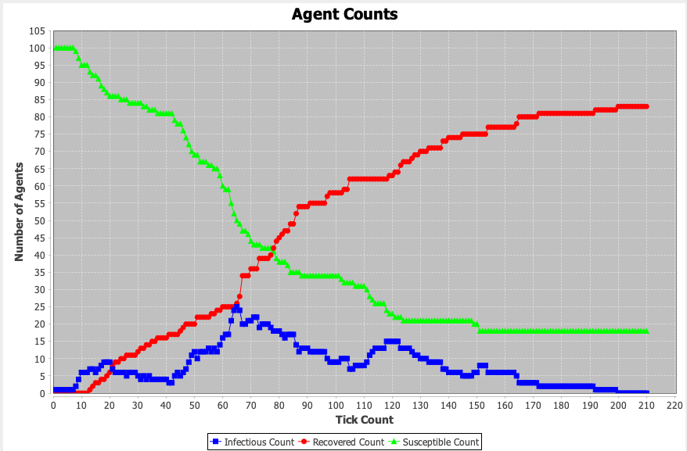
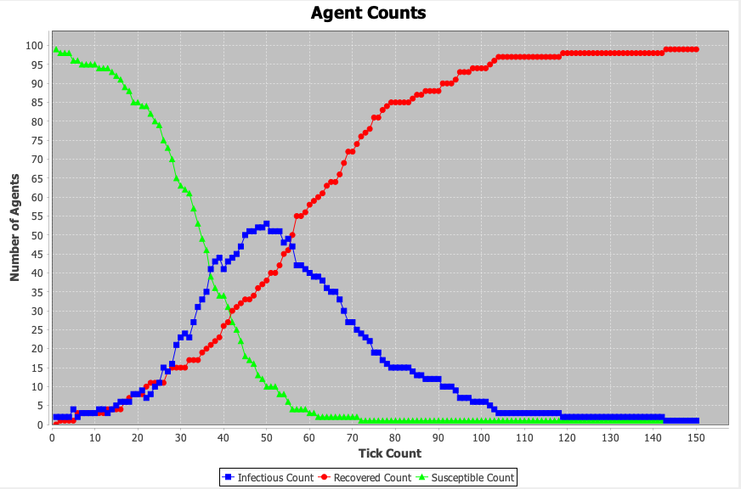
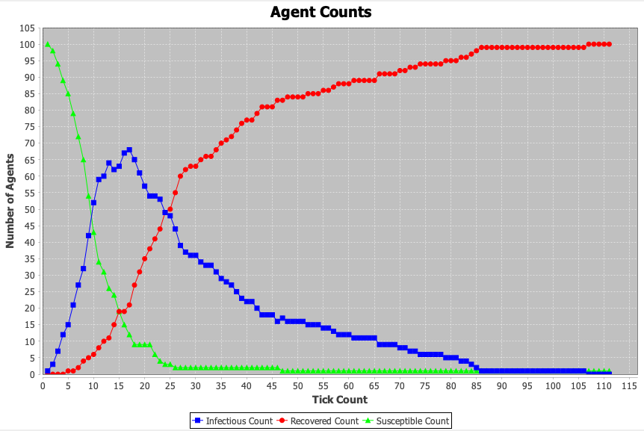
SIR Epidemiological Model using Barabasi Albert Graph
d = 8
d: degree of each new node added for Barabasi Albert Graph
d = 16
d = 32
For all Graphs
b =0.01
g = 0.05
n = 100

Slide 7
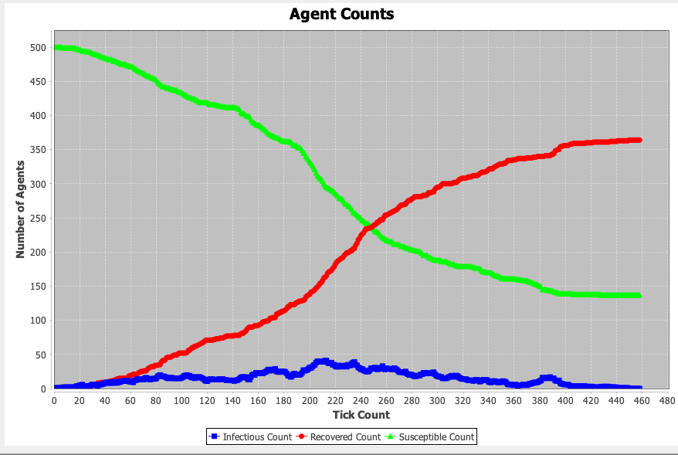
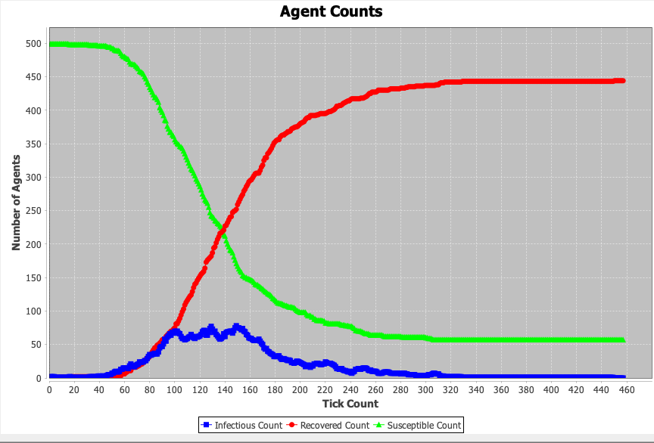
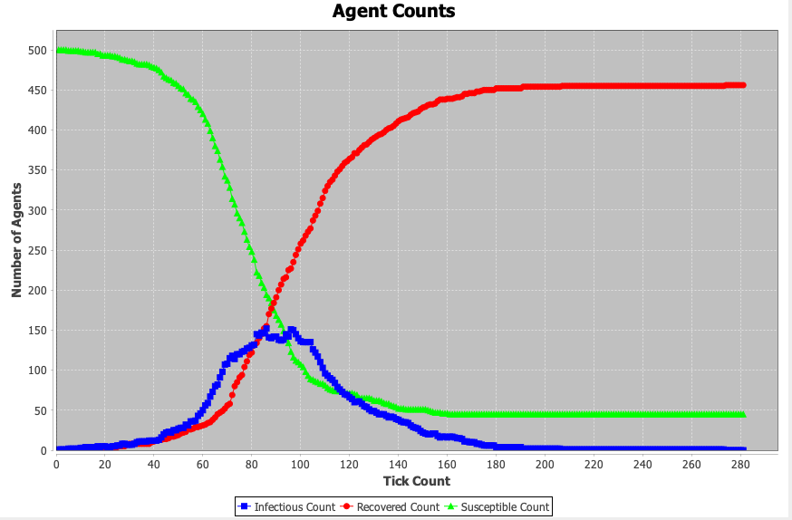
SIR Epidemiological Model using Watts Strogatz Graph
b_watt = 0.01
b_watt: probability of replacing edge in ring lattice with new edge for Watts Strogatz Graph
b_watt = 0.1
b_watt = 0.5
For all Graphs
b =0.01
g = 0.05
n = 100
d = 16

Slide 8
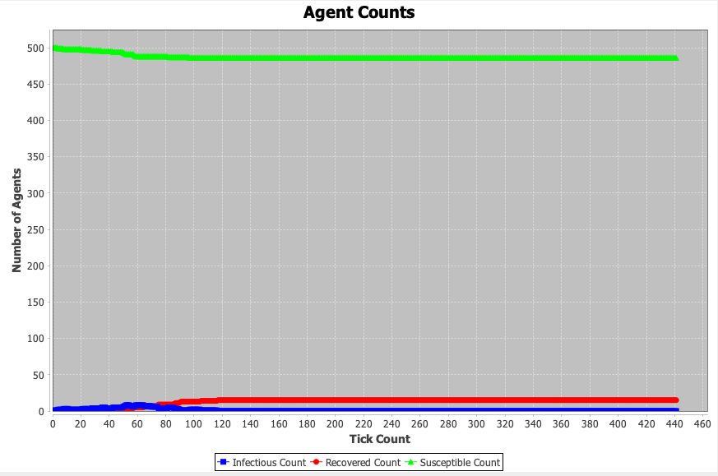
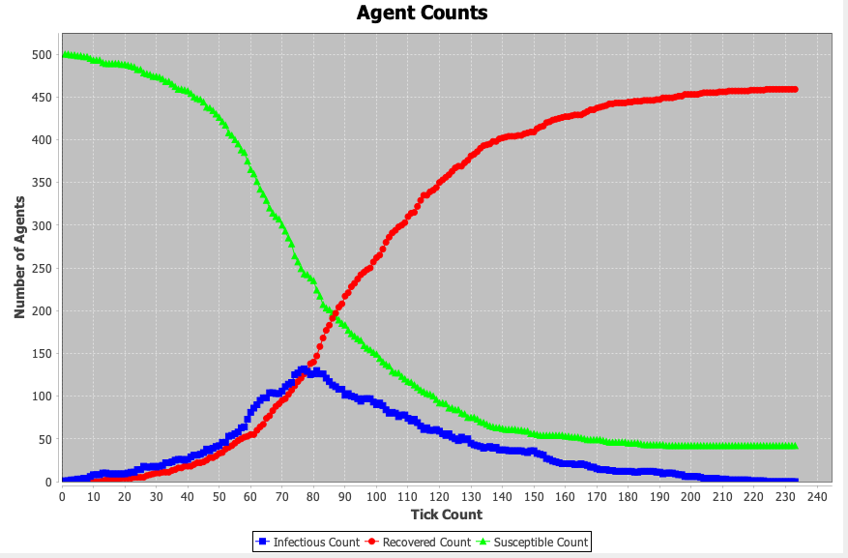
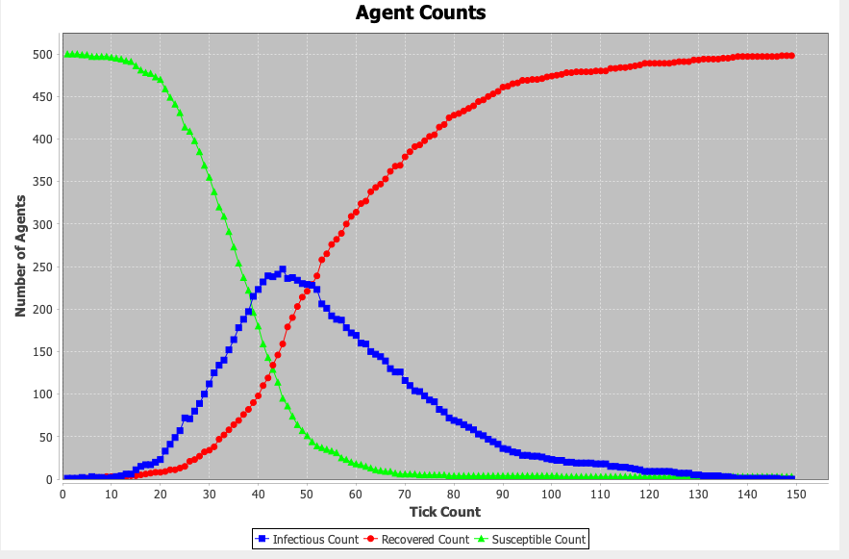
SIR Epidemiological Model using Watts Strogatz Graph
d = 8
d: degree of node in ring lattice for Watts Strogatz Graph
d = 16
d = 32
For all Graphs
b =0.01
g = 0.05
n = 100
b_watt = 0.1

